Slide 1
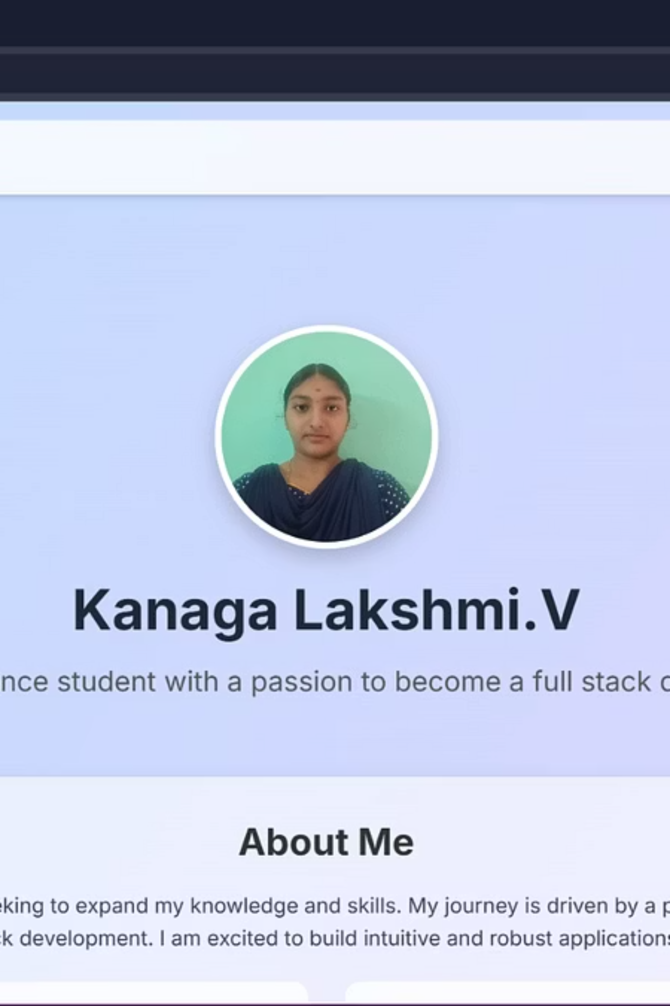
Digital Portfolio:
Your Digital Identity
STUDENT NAME: V.KANAGA LAKSHMI.
REGISTER NUMBER: 222402616
NM ID: asunm161222402616
DEPARTMENT: DATA SCIENCE
COLLEGE: PRINCE SHRI VENKATESHWARA ARTS AND SCIENCE COLLEGE
Notes:
Welcome everyone to our presentation on the Interactive Digital Portfolio project. This slide introduces the core purpose of the project - to create a dynamic personal website that showcases your skills, education, and professional presence in the tech industry. The homepage design features a clean, modern aesthetic with a subtle gradient background, a circular profile picture, and elegant typography. The overall mood is sophisticated and inviting, with a focus on presenting your digital identity in a visually compelling way. This website will be an interactive platform for you to highlight your unique qualifications and experiences to potential employers or clients.

Slide 2
PROJECT TITLE:
DIGITAL PORTFOLIO
1
2
3
Project Name
Objective
Key Theme
Interactive Digital Portfolio
To build a personal portfolio website showcasing skills, education, and contact information for aspiring full-stack developers and data scientists.
Modern Gradient Theme: Soft blue to purple background with a minimalist, clean, and card-based layout.
The goal is to balance professional polish with creative flair, ensuring high readability and a modern user interface, incorporating interactive elements like hover effects, animations, and smooth scrolling for an engaging user experience.

Slide 3
AGENDA:
01
02
03
PROBLEM STATEMENT
PROJECT OVERVIEW
END USERS
04
05
06
TOOLS & TECHNOLOGIES
PORTFOLIO DESIGN & LAYOUT
FEATURES & FUNCTIONALITY
07
08
09
RESULT & SCREENSHOTS
CONCLUSION
GITHUB LINK

Slide 4

PROBLEM STATEMENT:
Digital Portfolios: A Modern Alternative to Traditional Resumes
The Problem Identified
Why This Project Matters
Traditional resumes, while foundational, are static and severely limit the ability to showcase creativity, technical skills in action, and personal brand. Recruiters often seek quick, engaging, and interactive ways to assess candidates, making conventional formats less effective in a competitive tech landscape.
To visually highlight diverse skills, educational background, and completed projects.
To provide an intuitive and efficient way for recruiters and peers to connect and understand a candidate's potential.
To ensure a fully responsive portfolio, seamlessly accessible from both mobile and desktop devices, catering to modern browsing habits.
Lack of a dynamic and accessible platform for personal branding.

Slide 5



PROJECT OVERVIEW:
Interactive Skills Portfolio
About Me Section
Education Section
A personal introduction detailing the journey and passion, alongside a clear presentation of my programming and design skills.
Showcasing my academic qualifications, presented clearly and concisely.
Contact Section
Essential contact information including my email and others have been included in this section.
Each section is designed to contribute to a cohesive digital identity, serving both professional and academic networking purposes effectively.

Slide 6
WHO ARE THE END USERS?
Students – to creatively present their academic journey and skills
Job Seekers – to highlight programming, design, and professional abilities beyond resumes
Recruiters & Employers – to evaluate true potential through an interactive portfolio
Academic Institutions – for project assessments, reviews, and networking

Slide 7
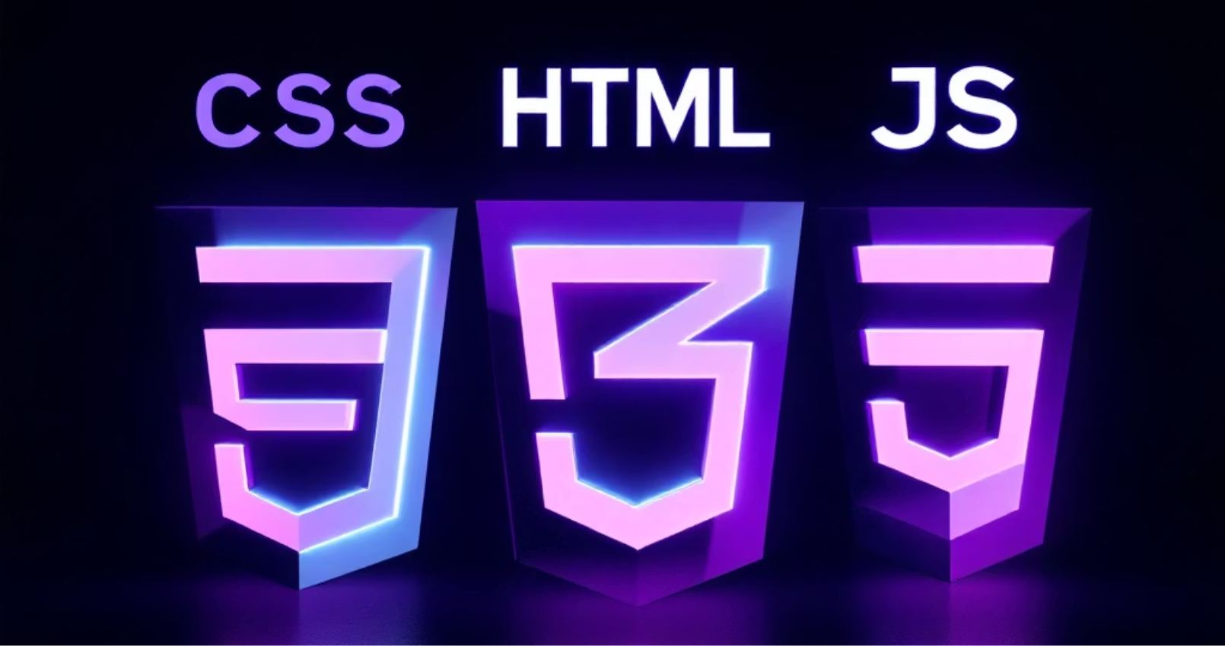
TOOLS AND TECHNIQUES :
Leveraging Modern Web Technologies
Languages Used
Libraries & Platforms
HTML: Provides the core structure and semantic organization
Tailwind CSS (CDN): Rapid UI design with consistent styling
CSS (Tailwind + Custom): Handles styling, layout, responsiveness
Font Awesome: Scalable vector icons for social media & contact
JavaScript: Adds interactivity and scroll animations
Google Fonts (Inter): Clean, modern, and readable typography
Deployment: Hosted via GitHub Pages (with local hosting option)

Slide 8
PORTFOLIO DESIGN & LAYOUT :
Intuitive Navigation & Aesthetic Appeal
Header & Navigation
Home Page Design
Sticky navigation bar with links: Home, About, Education, Contact
Hero banner with circular profile photo
Always accessible for smooth browsing
Engaging tagline to welcome visitors
Content Sections Layout
Responsiveness
About Page: Grid-based layout for programming & design skills
Tailwind CSS ensures seamless experience across laptop & mobile
Education Page: Card-style layout highlighting academic milestones
Layout adapts automatically to any device
Contact Page: Email + clickable GitHub, LinkedIn, Instagram icons
The design prioritises user experience by combining clean aesthetics with functional navigation.

Slide 9
FEATURES ANF FUNCTIONALITY :
Enhancing User Engagement Through Dynamic Features
Animations & Effects
User Engagement & Interactivity
Animations & Effects
Navigation links with smooth, animated scrolling
Hover effects on profile photo, cards, and navigation links
Contact icons with hover zoom effect for clickable feedback
Smooth transitions: fade-in and slide-up effects for text & images
Attractive gradient background (blue → purple) for modern aesthetic
JavaScript scroll animations using Intersection Observer API
Responsive layout ensuring flawless display on laptop & mobile

Slide 10
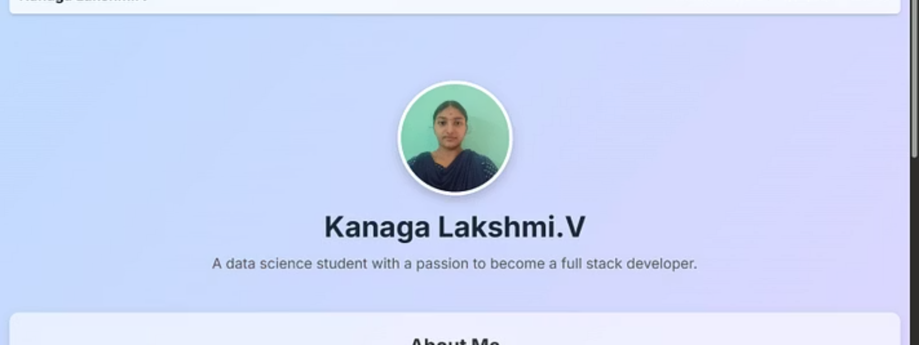
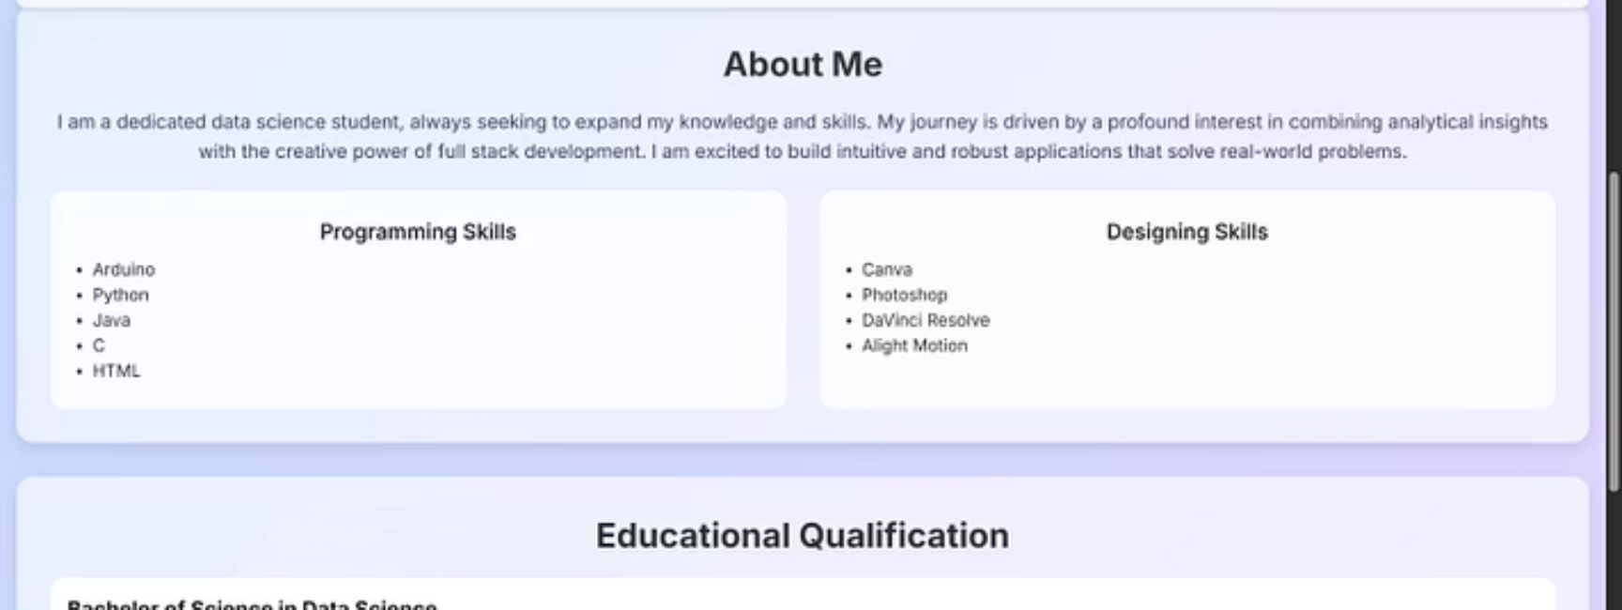
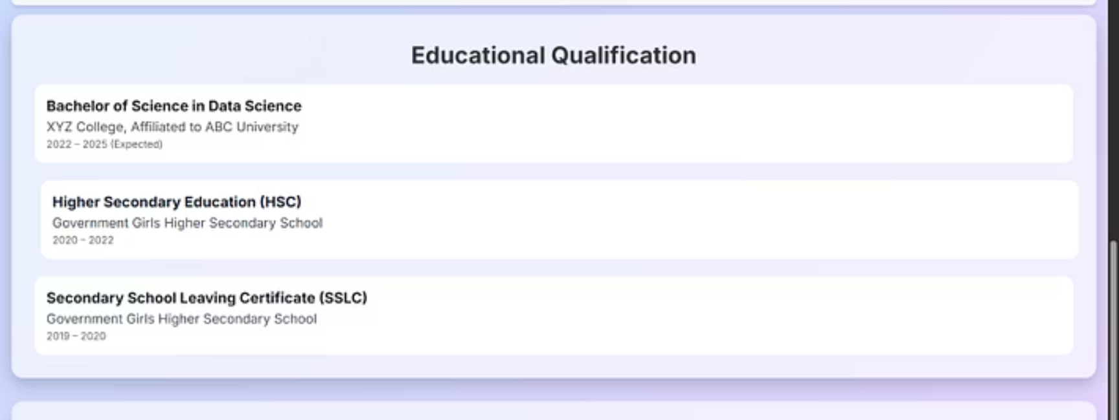
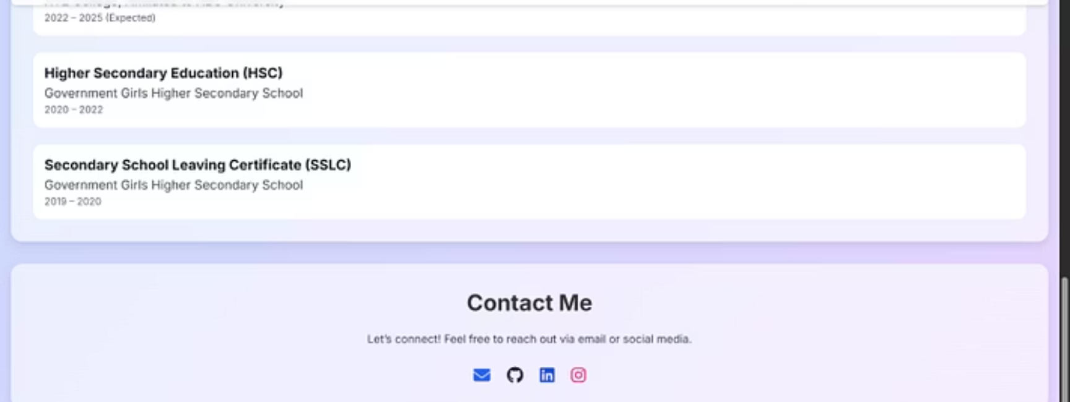
RESULTS & SCREENSHOTS :
Showcasing the Interactive Digital Portfolio
The result is a fully functional and aesthetically pleasing portfolio website with modern UI and smooth animations. It effectively showcases personal details, educational background, and technical skills, providing easy access to all relevant contact links. These screenshots offer a glimpse into the polished design and intuitive user experience of the completed project.

Slide 11
CONCLUSION
Your Digital Footprint for Success
Key Highlights
Societal & Professional Impact
Key Highlights
Societal & Professional Impact
Built with HTML, CSS, JavaScript, using Tailwind CSS & Font Awesome
Helps aspiring developers showcase skills dynamically
Assists recruiters in evaluating candidates beyond static resumes
Fully responsive & interactive, adapting to all devices
Essential sections: Introduction, Skills, Education, Contact
Promotes digital self-representation in the professional world
More than a website → a living resume and personal brand identity

Slide 12
GITHUB LINK:https://kanagalakshmi157.github.io/TNSDC-FWD-DP/

